Slide 1
Managing planning departments workshop
Richard Crawley, Programme Manager
PAS Conference 2015
www.pas.gov.uk

Slide 2
90 min workshop
Introductions & teams
What to do ?
How to do it ?
Review
Notes:
2014 total stats

Slide 3
Introduction
Learning by doing
Small teams
Scenario (but not role play !)
10 mins Create teams, mill about
30 mins What to do ?
30 mins How to do it ?
20 mins Review & prize

Slide 4

Form teams
Numerate ?
Experienced ?
Neither ?
Small teams (side note:
smaller than you might think)
Team name ?

Slide 5
Task 1 : What to do ?
Before we start, without knowing anything about the scenario
Three bits of advice onto a post it
How to balance the books ?
You have 4 minutes … (write legibly please, inc team name)

Slide 6
Task 1 : What to do ?
You have a hand-out
  Costs and incomes
  Service snapshot
  If you want to know anything else, ask
Your task
  Four things to do, that will deliver budget target
    Each one should follow an outline
    What is it ? How much ? How simple ?
    Prepare to shout them out

Slide 7
How to read this budget
Costs are positive
Income is negative
310 - Pre-application (paid) | 82 | -51 | 31

Slide 8
Some advice
Yes, the obvious stuff
  Reduce costs
  Increase income
But you are free to think big, creative thoughts
  You are in a spot ! It’s a good time to go for it
Think:
  inside, outside [the department, the council]
  forwards, backwards [the processes]
  Use the budget. Don’t sweat the small stuff

Slide 9
Task 1 : What to do ?
Share
Anyone gone any further ? Blue sky thinking ?

Slide 10
Task 2 : How to do it
Abstract thinking is great, but execution is the thing
The world has not stopped, and your ideas need to mesh into a busy service
Three bits of advice – how to execute projects in a busy service
You have 4 minutes (write legibly)

Slide 11
Task 2 – How to do it
Service is not going so well
  Validation backlog (many cases > 30 days)
  Pre-applications on back-burner
  Corporate complaints (and councillor complaints) going up, esp
    Validation
    Heritage
    Pre-application
ICT system change overdue. Should have been in 2014

Slide 12
Task 2 – how to do it
Staff are not happy
In the region, sharing has been talked about but only ever talked about
In what sequence do you do things ?
What do you say to the various stakeholders ?
Four things, in order

Slide 13
Task 2 – how to do it
Share
Anyone disagree ?

Slide 14
My thoughts – Task 1
Transfer cost to applicants & agents
  Pre-app (think about value)
  Receipt (“those applications which are in accordance with the nppf”) or even onsite (eg trees)
Reduce cost of service by establishing trust and confidence in staff to do only what is needed
Plan-making as a region
  Start with evidence base

Slide 15
My thoughts – Task 2
One service – one response. But let people know the endpoint.
Extra (new) resources are not the answer. Get people to give more.
Focus on comms. Do people in a queue know they’re in a queue ? Is it a fair queue ?
Start today. Do only what is required. Ask only when needed. Risk-based approach.

Slide 16
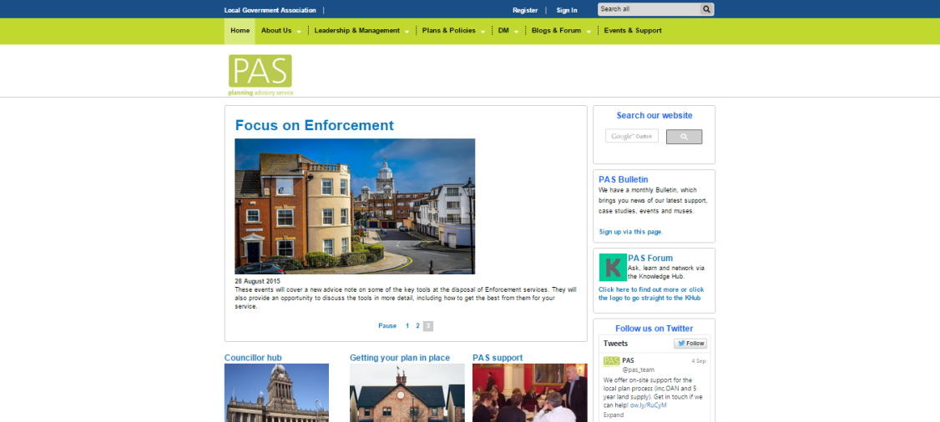
We are at
www.pas.gov.uk
@pas_team
Don’t forget the bulletin. It’s not another news service.

Slide 17

Richard.Crawley@local.gov.uk
@RichardatPAS
pas@local.gov.uk
web www.pas.gov.uk
phone 020 7664 3000

