Slide 1

PAS Autumn Conference 1st October 2015
Southwark Council
`Client Side’
planning consultancy service
Rob Bristow
Group Manager – Major Applications
Southwark Planning Division

Slide 2
1. Southwark location

Slide 3
2. Corporate Challenges
Population increase: 306,700 (2015) to 371,900 (2040)
Housing Target: 2,736 units pa (London Plan 2015)
Direct delivery of 11,000 new council homes by 2043
(1,500 by 2018)
5,000 more local people into jobs
500 new affordable SME business units
Significant new school expansion programme
New leisure and community facilities

Slide 4
3. Delivery
Maximise the Council’s extensive property assets.
Southwark owns 45% of borough
Estate regeneration + Managing largest council housing stock in London
Town centre and area renewal
Led by the Council’s Regeneration and Housing divisions working with Planning

Slide 5
4. The Planning Division challenges
To facilitate regeneration programmes whilst facing a tightening budget
Demands from client divisions for planning advice earlier and throughout the process
Managing staff resources to ensure that the pipeline of proposals can be dealt with efficiently
Demonstrate better joined-up working with other Council divisions in delivering the corporate agenda

Slide 6
5. The Planning response: A `Client Side’ consultancy service
Selected Development Management officers act as planning consultants to internal clients
Officers advise clients from the outset on:
  site selection and scoping,
  design development
  supporting documentation
  pre-app and design review
  planning submission and advocacy during the application
  planning conditions/obligation discharge
  post-decision minor amendments
Fees charged per project to clients’ capital budgets
Client Side officers kept separate from LPA handling of internal proposals
Governed by Service Level Agreements between Planning and client divisions

Slide 7
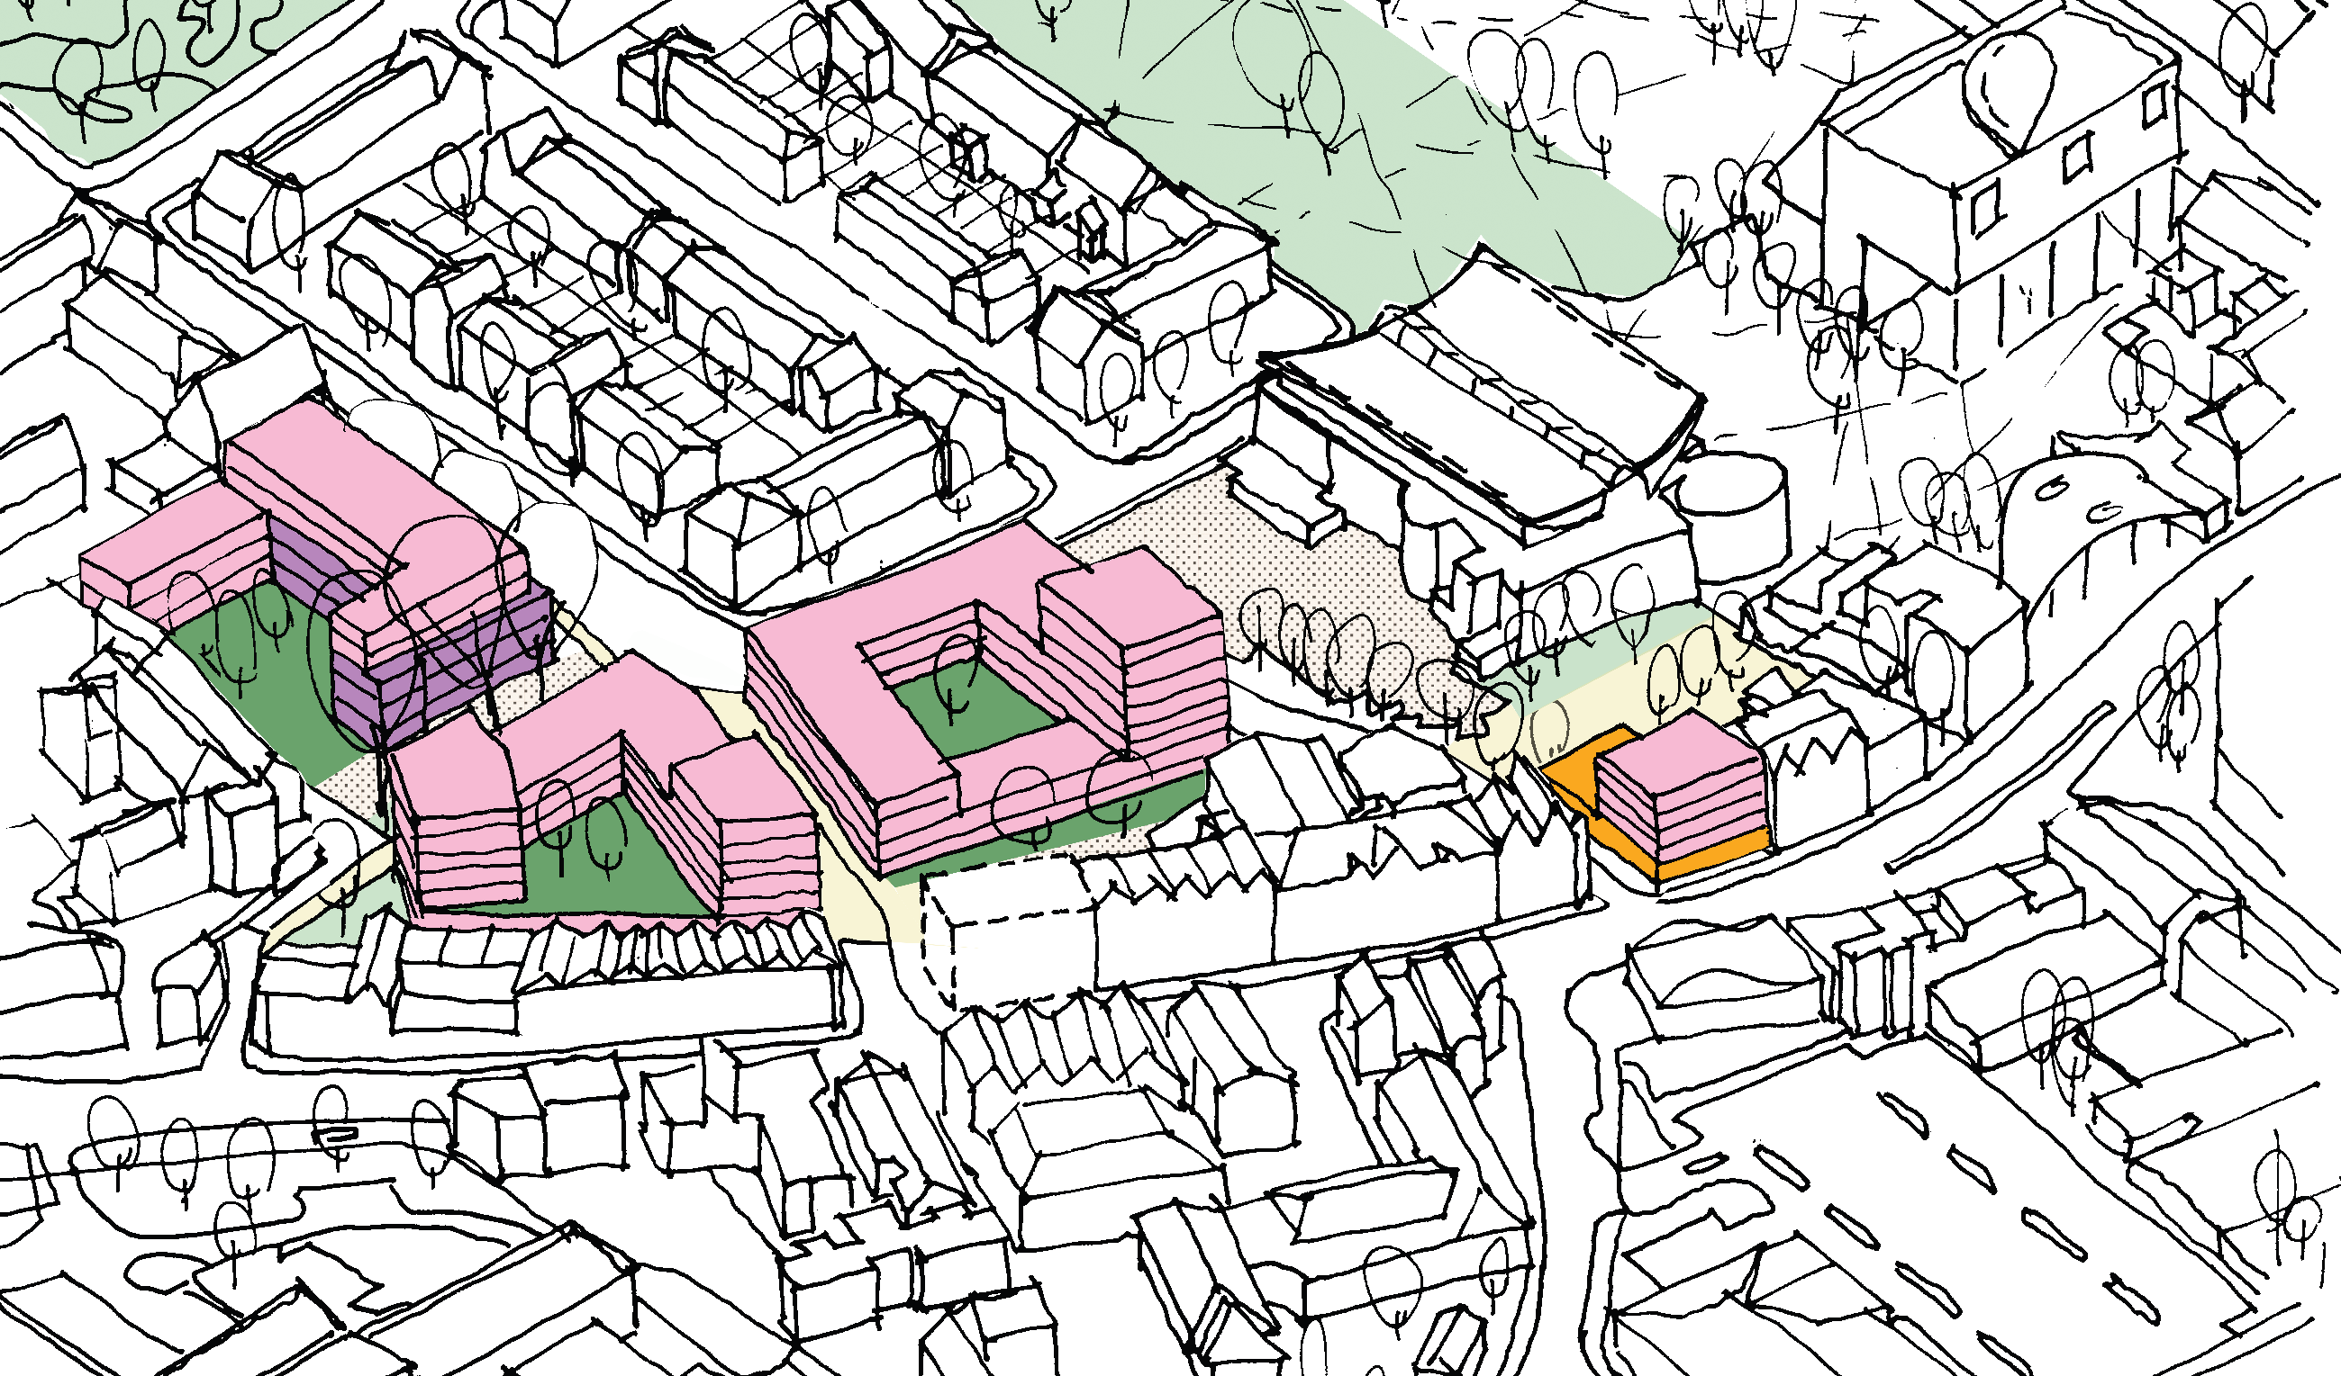
Examples of Client Side projects
Flaxyards and Sumner Road, Peckham

Slide 8
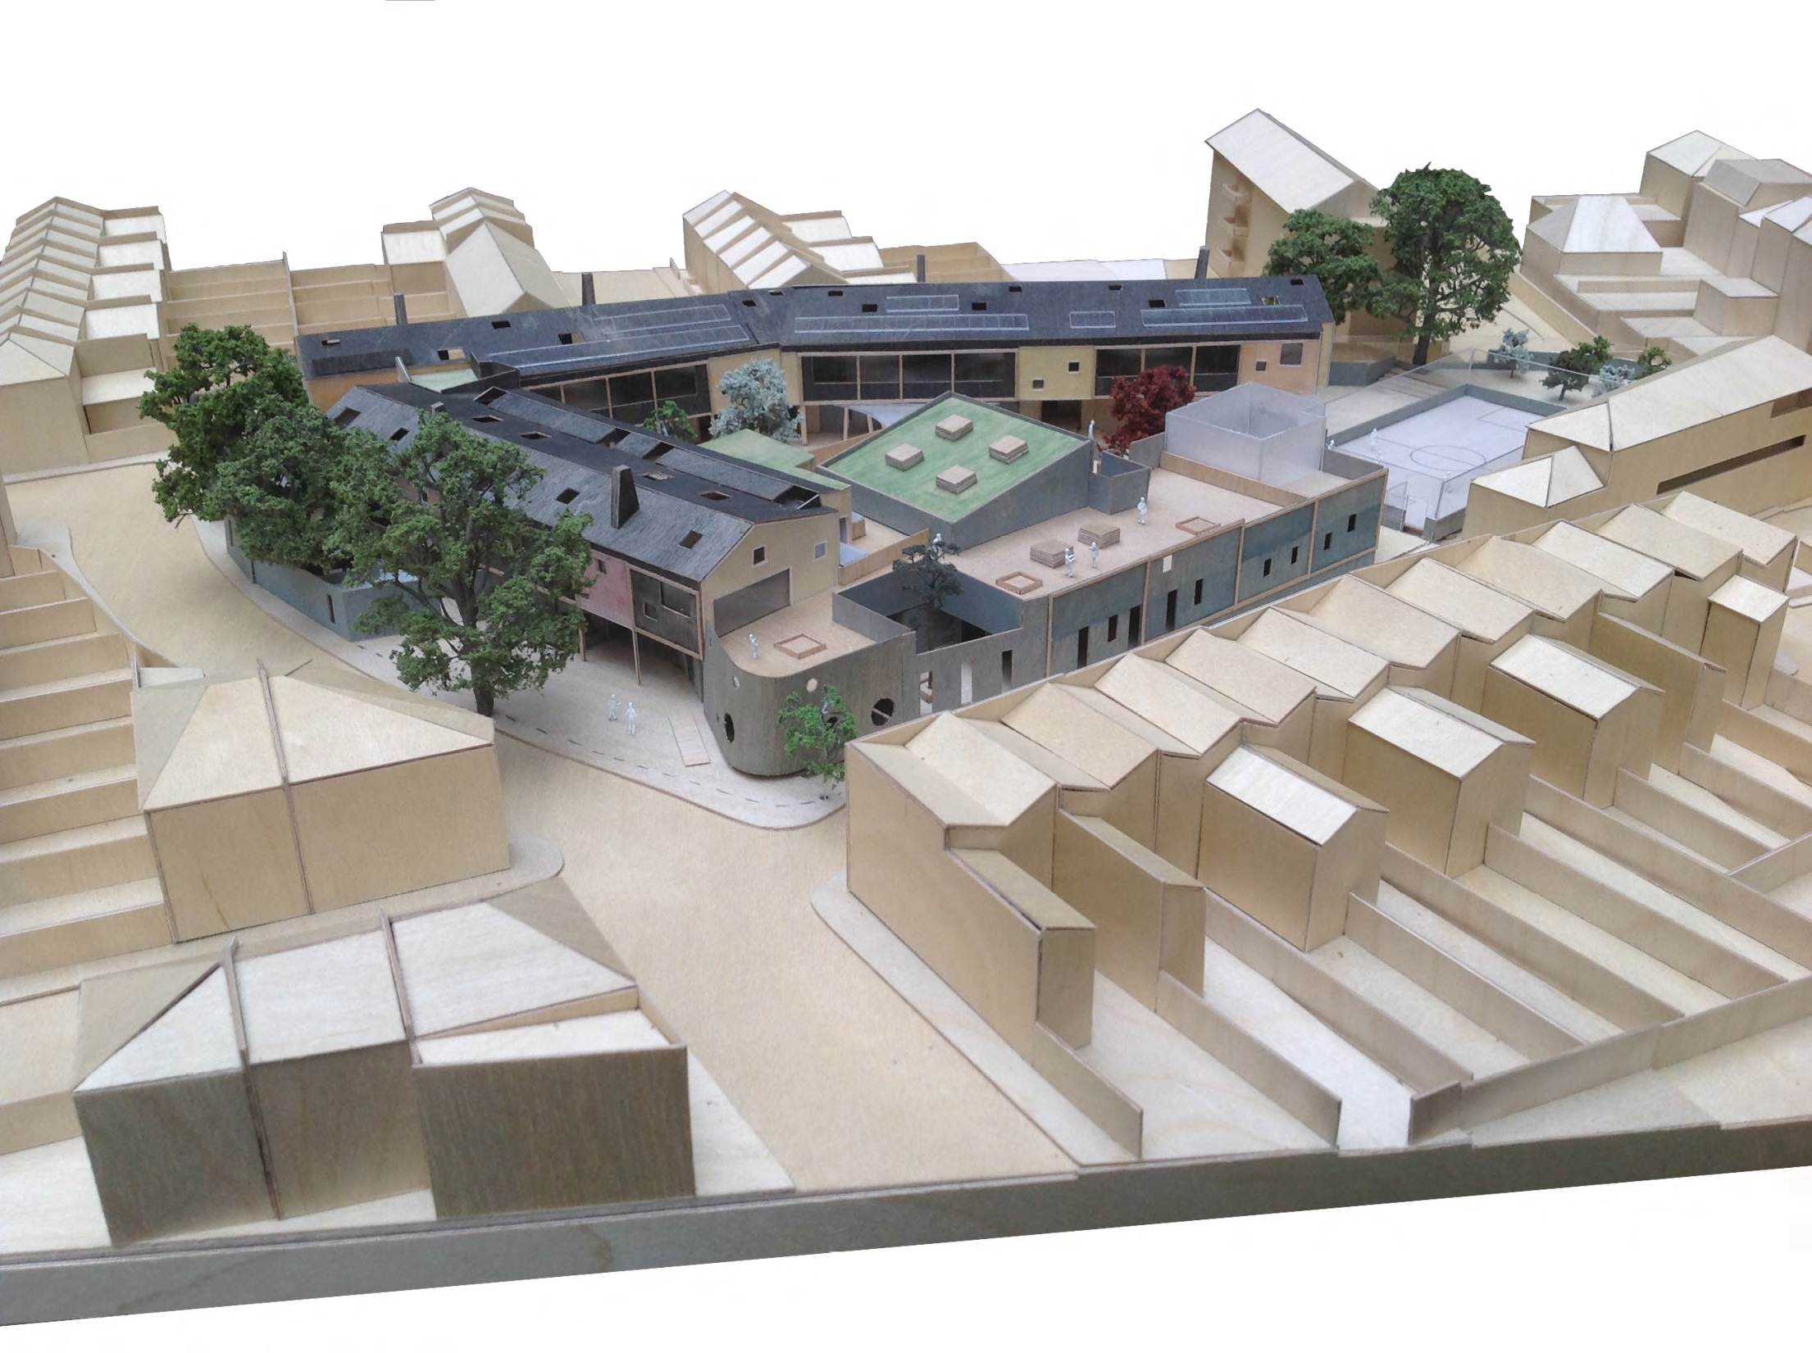
Examples of Client Side projects
Bellenden Primary School, Peckham

Slide 9
6. Benefits of Client Side service
More efficient delivery of the development programme
Effective joint working has raised the profile of Planning within the Council - demonstrating that it is essential to the corporate agenda
Clear understanding of the development pipeline so that LPA resources can be better managed in preparation
Increased skills and experience amongst client side officers
Maintaining capacity and resilience in the Planning Division
Supported by new income stream from fees
Closer working relationships with client divisions
Reduced consultancy spend for clients

Slide 10
7. Mitigating risks
Probity
A clear protocol has been prepared which sets out the terms of the service
Transparency is key
Ensuring confidence in the service provided
Experienced officers with a facilitative approach are essential
Management oversight
Member and Chief Executive support
Resource management
Ensure flexibility so that officers can switch with DM duties as required
Regular review of development pipeline

Slide 11
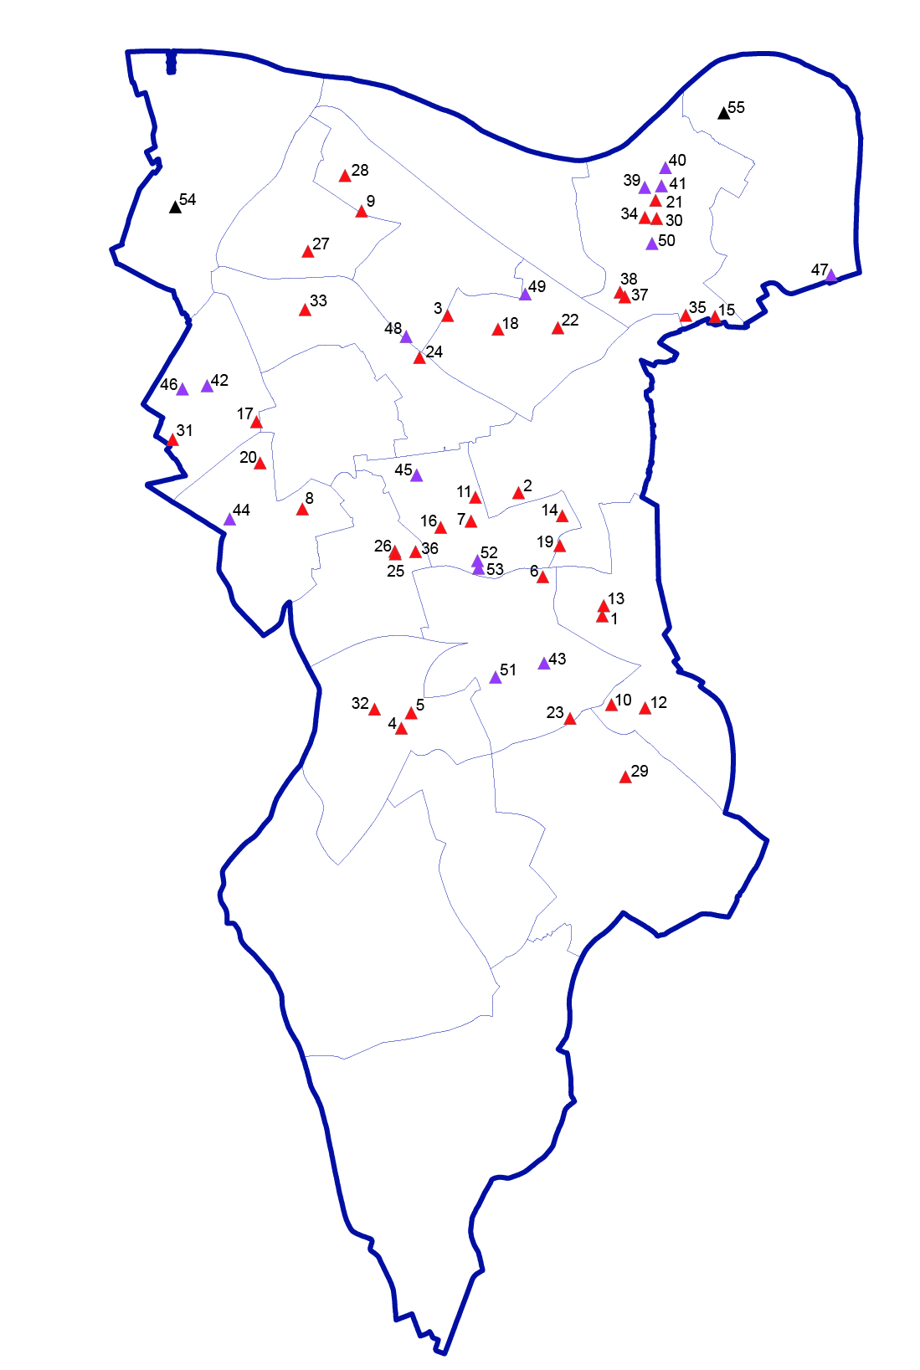
8. Going forward
Over 50 projects in the pipeline for
2015 -17 period
Necessitating an increase in number of client side officers
Dissemination to wider staff group to learn from consultancy experience
Monitoring fee income against time provided to ensure costs are recovered

